Slide 1
Purifying Water
Killing Bacteria That
Could Cause Illness

Slide 2
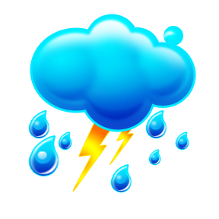
What would you do if you ran out of safe drinking water during a disaster?
Sources of Water for Purification
  Rainwater
  Streams
  Rivers
Before Purifying
  Let water settle to the bottom of the container.
  Strain water through a clean cloth or paper towel.

Slide 3
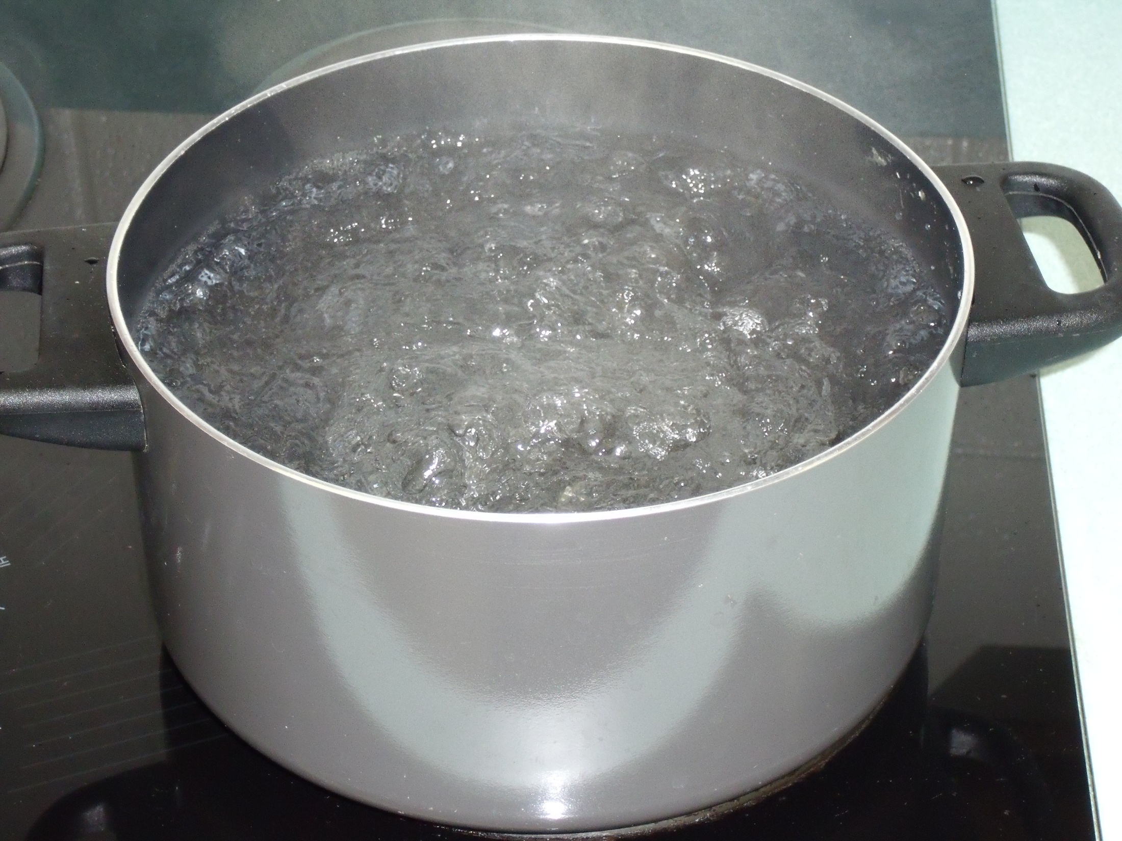

Purifying Water By Boiling
Put water into a clean pot.
Bring to a rolling boil and boil for at least 3 minutes.
Cool water before using unless it is being used for cooking.

Slide 4
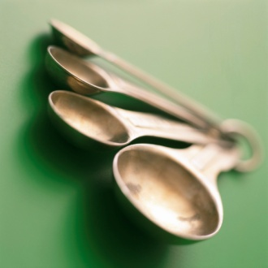
Purifying Water With Bleach
Place one gallon of water into a clean container
Add ¼ teaspoon of unscented household bleach (5.25% Sodium Hypochlorite)
Stir
Wait 30 minutes
There should be a faint odor of bleach. If not repeat the procedure.

Slide 5
Do Not Drink Any Water That Has Come Into Contact With Flood Water!
IT CANNOT BE PURIFIED!

Slide 6
Conclusion
Rainwater, streams, and rivers are a good source of water for purification.
Water must be filtered before purifying.
Water can be purified by boiling for 3 minutes.
Water can be purified by adding ¼ teaspoon of bleach to one gallon of water.
Flood waters cannot be purified.

